Slide 1

Automation of Campus Recruitment
Process in Engineering Colleges

Slide 2
Automation of Campus Recruitment
Process in Engineering Colleges
By
GITESH JAIN,
Institute of Engineering and Management
(IEM)

Slide 3
CONTENTS
Objective
Scope
Modules Description
Functional Requirements
Application Workflow
Future Scope of Improvements
Conclusion
References

Slide 4
OBJECTIVE
Automate the entire process of Campus Recruitment
Primary project goals :
Build and brand the Campus Portal to promote a healthy,
streamlined environment
Easily manage student registration for the jobs being offered
at your university
Automate your student assessment process

Slide 5
SCOPE
24x7 ACCESS
BENEFICIAL
UPLOAD DETAILS
VACANCY CHECKING
APTITUDE
CONTROLLED BY ADMIN

Slide 6
MODULES DESCRIPTION
Admin login
Student login
Company login
Company can view student data
Student can view company data
Admin dashboard has overall functional rights
Appropriate data processing and handling

Slide 7
FUNCTIONAL REQUIREMENTS

Slide 8
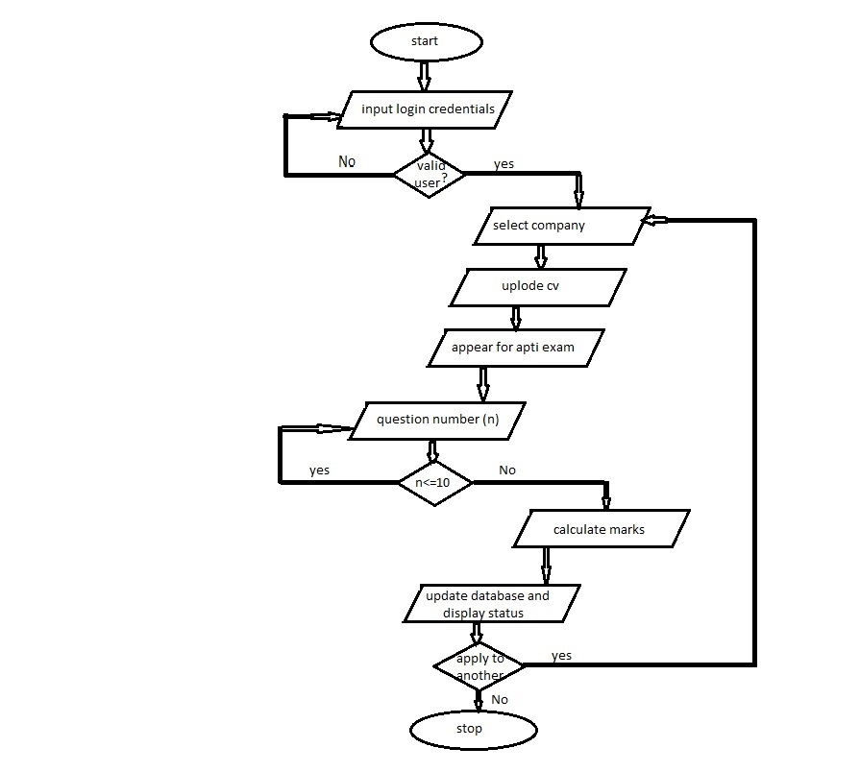
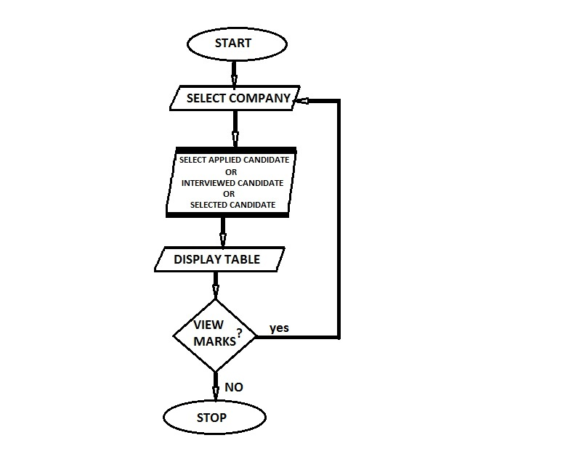
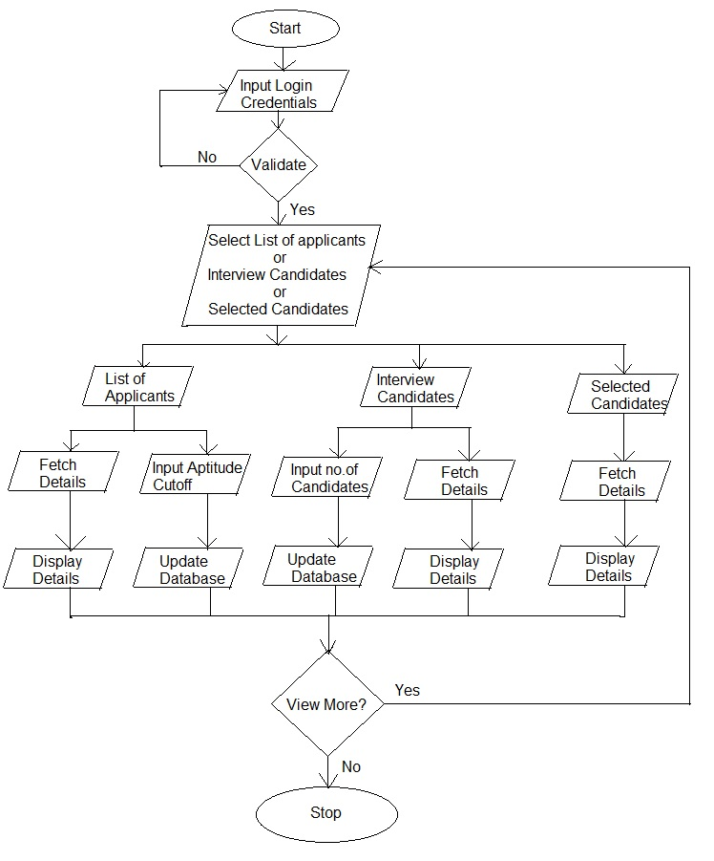
STUDENT AS A USER
COLLEGE AS A USER
RECRUITER AS A USER

Slide 9
APPLICATION
USER
INTERFACE

Slide 10
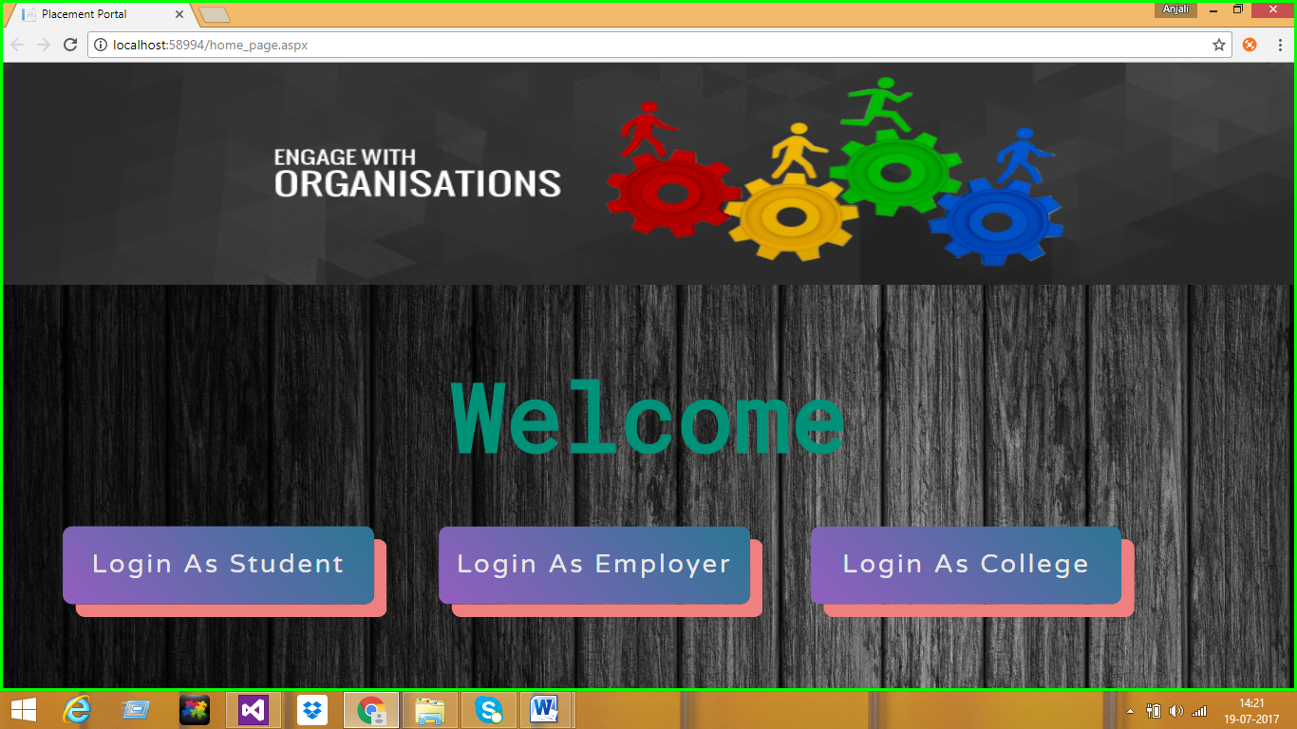
HOME PAGE

Slide 11
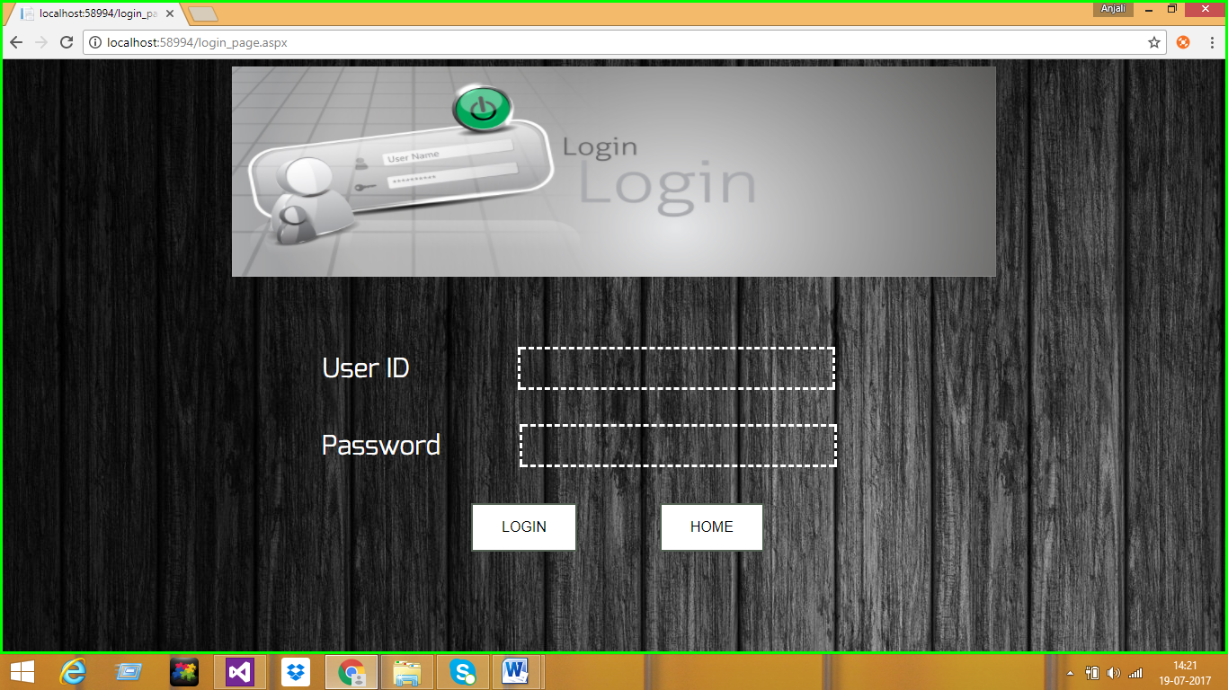
HOME PAGE
LOGIN PAGE

Slide 12
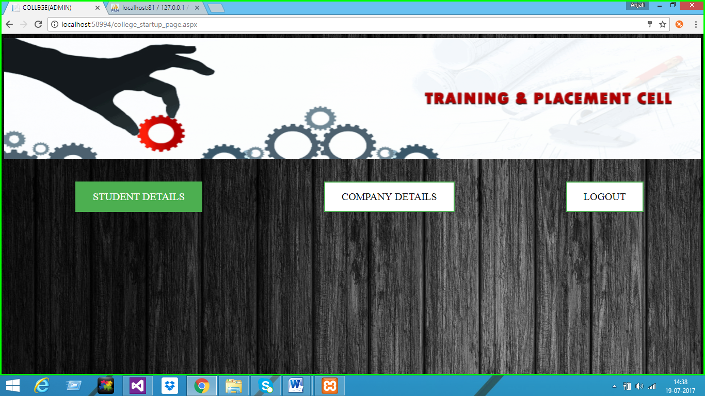
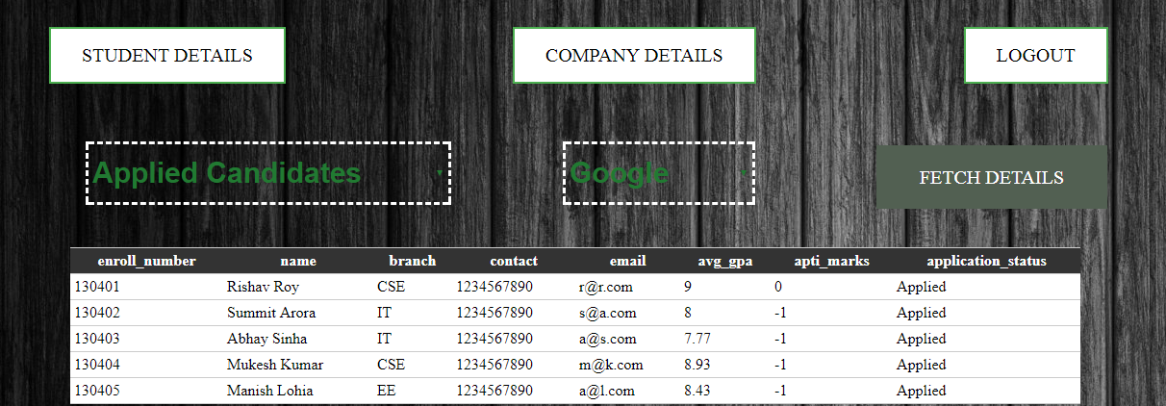
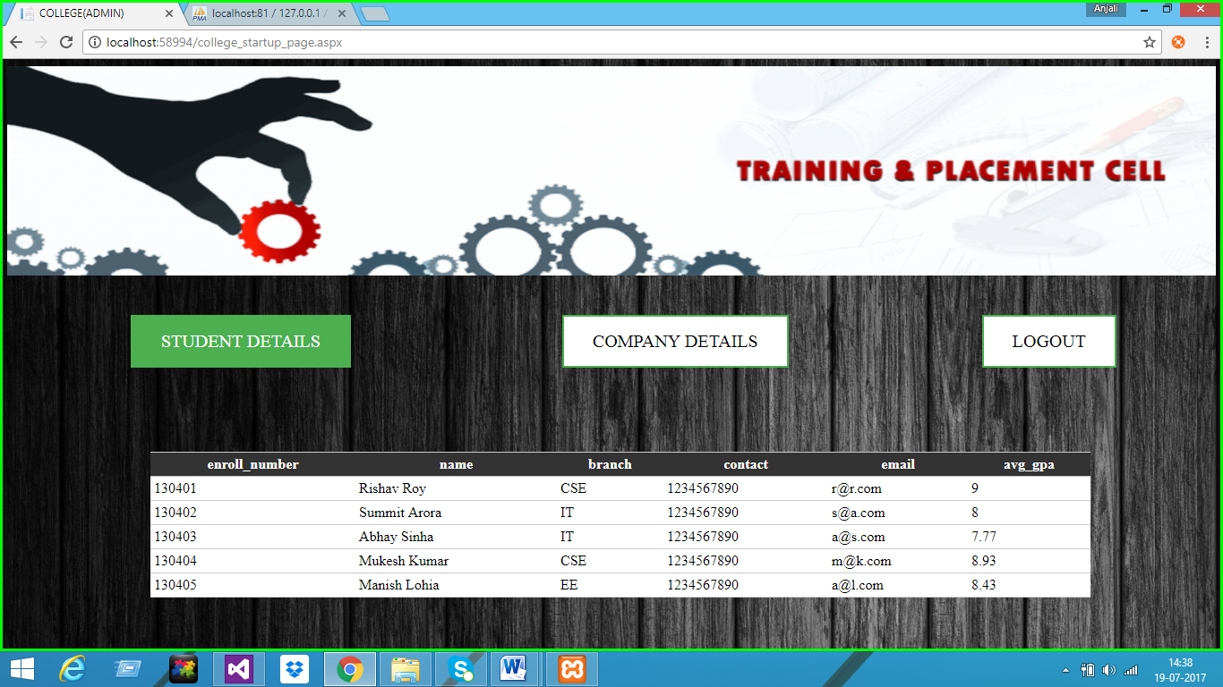
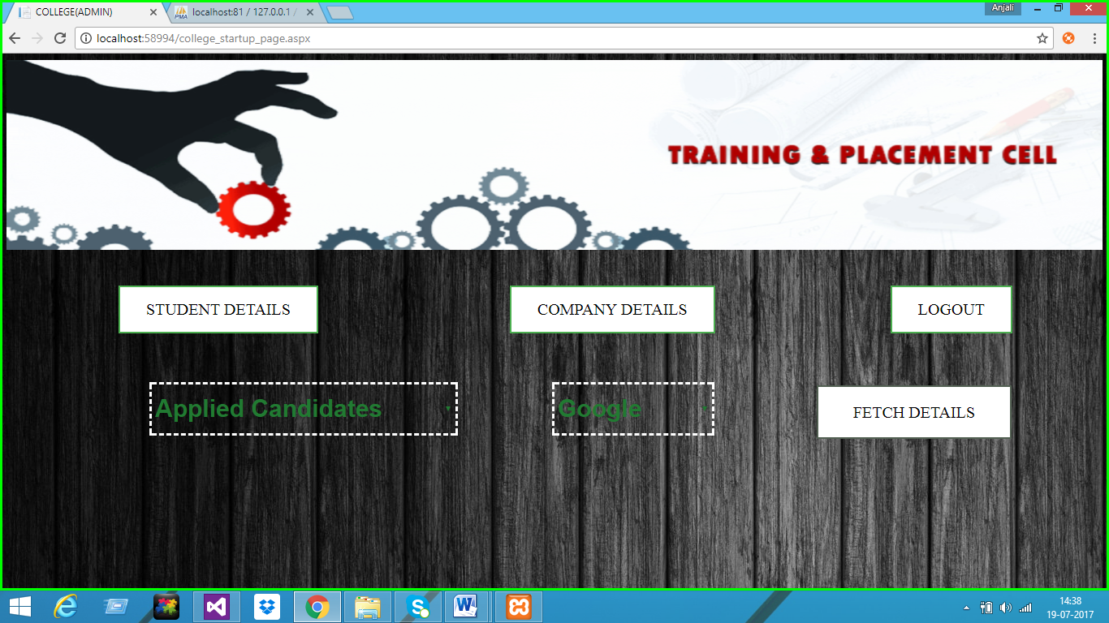
COLLEGE LOGIN

Slide 13
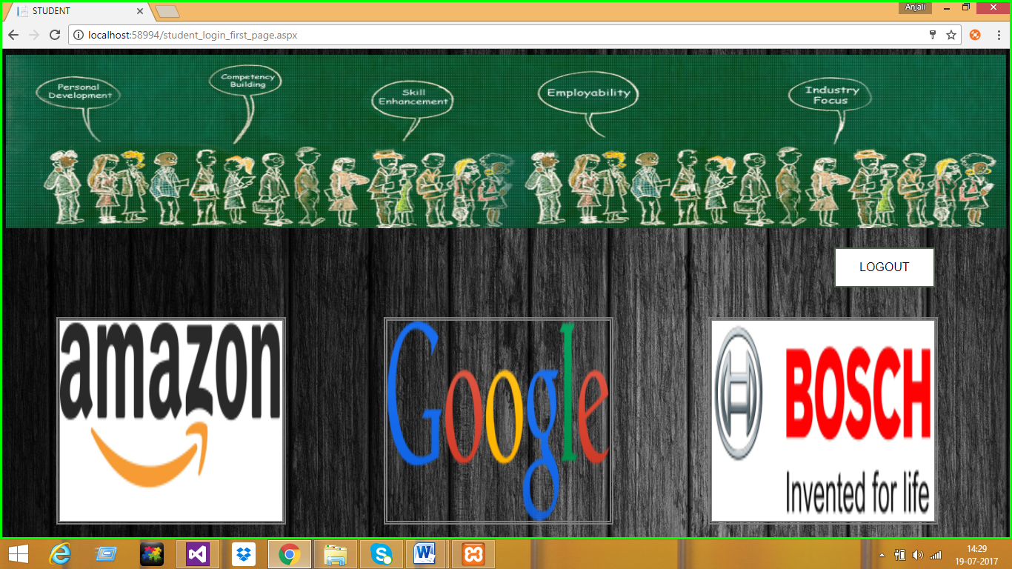
STUDENT LOGIN
COLLEGE LOGIN

Slide 14
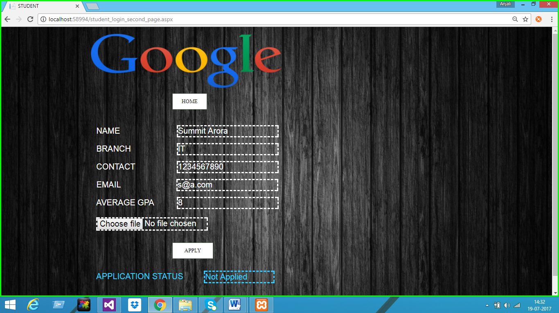

Slide 15
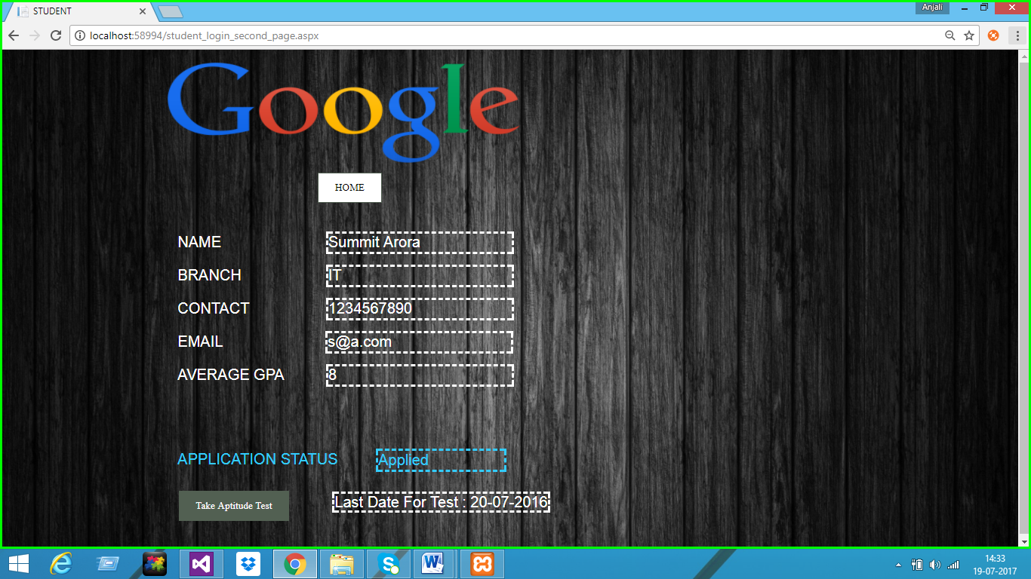

Slide 16
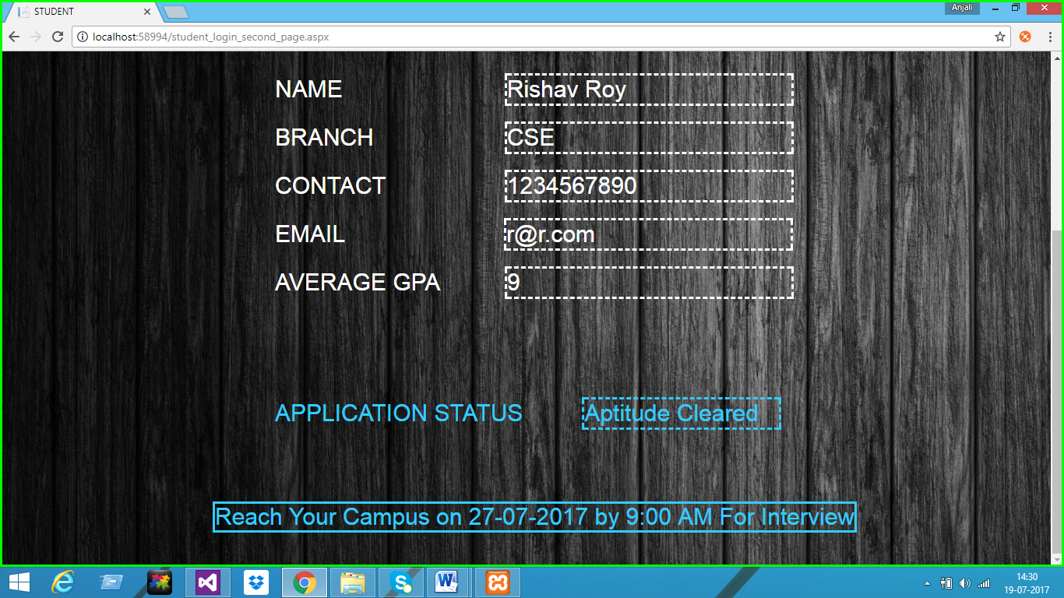
LOGIN PAGE

Slide 17
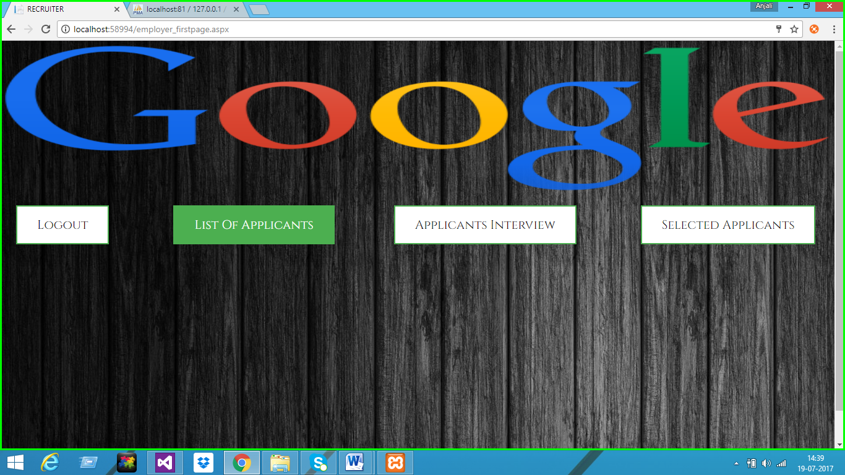
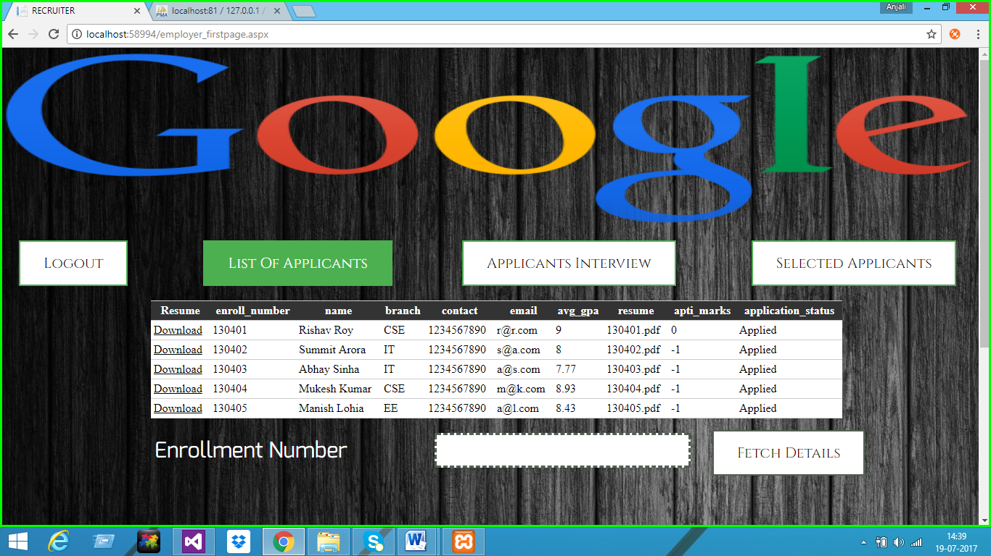
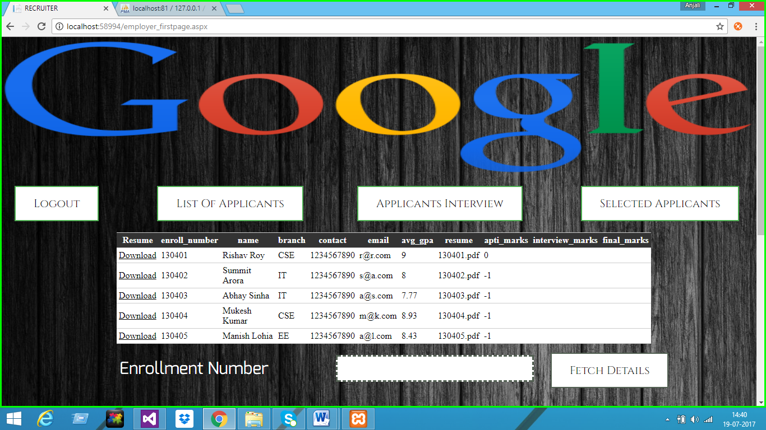
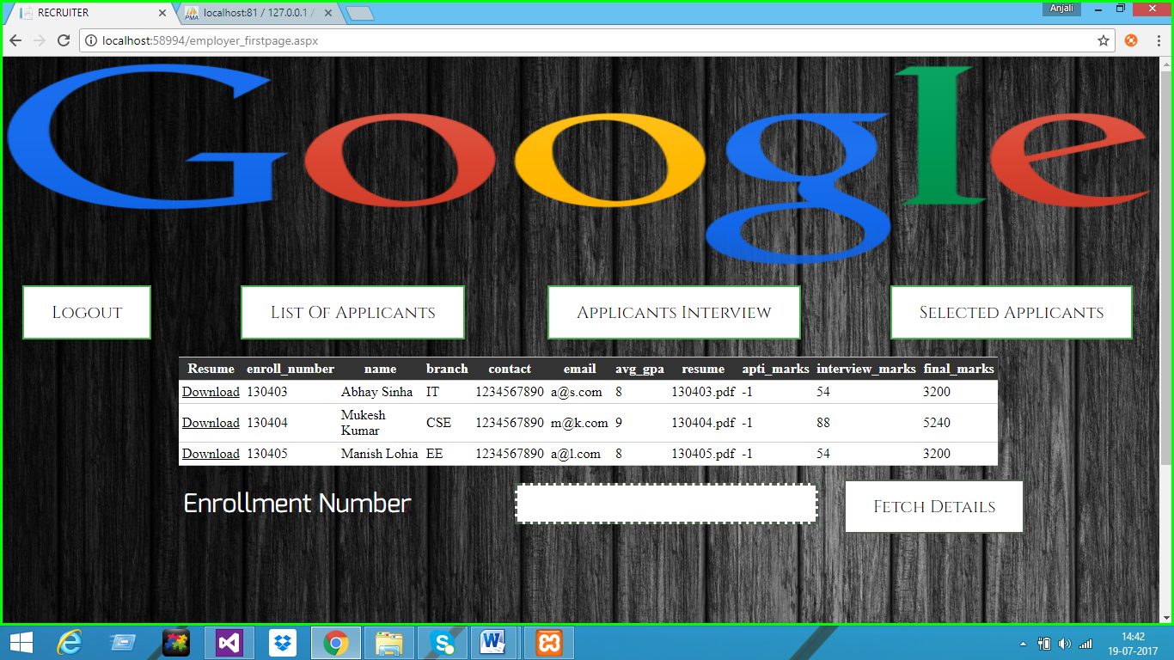

Slide 18
FUTURE SCOPE
Can make the system more advanced in terms of functionalities
Can introduce online interview process as well by using highly developed Artificial Intelligence
Can introduce more no of colleges within the same portal
Can incorporate other colleges and institutes apart from engineering as well
Can make this software so advanced that it will be used by all colleges and companies as a common portal for recruitment

Slide 19
REFERENCES
https://www.scribd.com/document/351485218/Campus-Recruitment-System#from_embed
https://www.classle.net/projects/node/3889/?ui=default
https://www.slideshare.net/hidaytulla/campus-recruitment-12955453
http://talentrecruit.com/talentrecruitcampus/

Slide 20
THANK YOU

